Slide 1
ROBOTIC SURGERY

Slide 2
CONTENTS
INTRODUCTION
HISTORY
TYPES OF ROBOTIC SYSTEM
WORKING OF ROBOTIC SYSTEMS
ADVANTAGES
LIMITATIONS
CONCLUSION

Slide 3
INTRODUCTION
Robotic surgery is the use of robots in performing surgery.
Major potential advantages of robotic surgery are precision and miniaturization.
Further advantages are articulation beyond normal manipulation and three-dimensional magnification.
At present, surgical robots are not autonomous, but are always under the control of surgeon
Robotic surgery is different from minimally invasive surgery

Slide 4
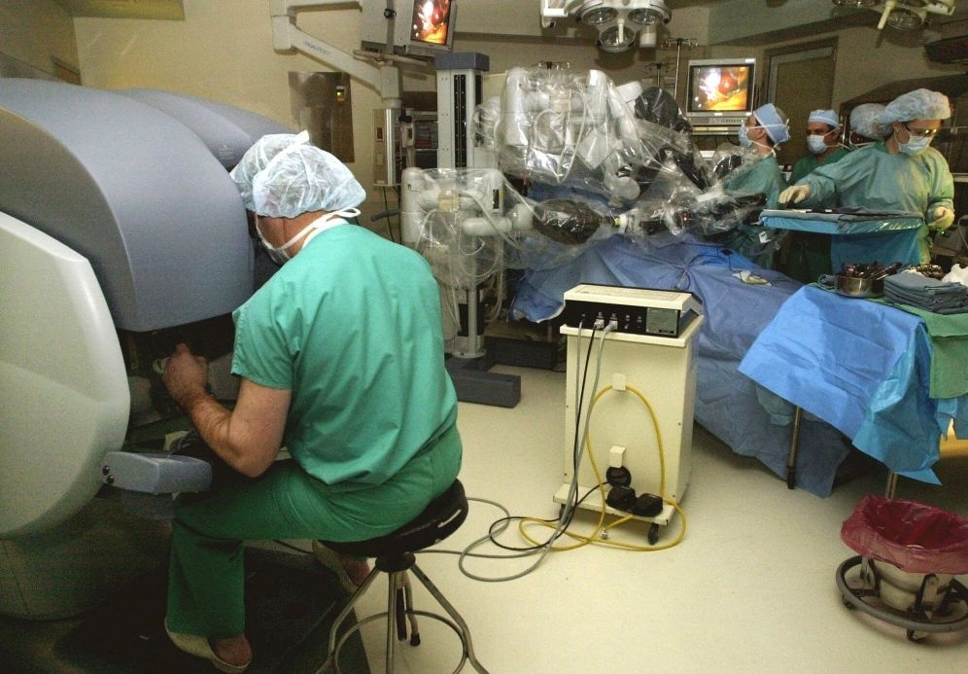
ROBOTIC SURGERY

Slide 5
HISTORY
In 1985 a robot, the PUMA 560, was used to place a needle for a ship replacement Intuitive Surgical System introduce the d a Vinci Robot in 1995.
In 1988, the PROBOT was used to perform prostatic surgery in England.
The ROBODOC from Integrated Surgical Systems was introduced in 1992rostatic surgery in England.

Slide 6
TYPES OF ROBOTIC SYSTEMS
Different types of robots are
1.Davince
2.Aesop
3.Hermes
4.Zeus

Slide 7
Da vinci surgical system
Da vinciSurgical System was the first operative surgical robot
incorporating the latest advancements in robotics and computer technology the davince surgical system.
The davinci deemed safe and effective by the united states food.
Aesop
Aesop's function is quite simple merely tomaneuvera tiny video camera inside the patient according to voice controls provided by the surgeo

Slide 8
zeus
Zeus contains robotic arms that mimic conventional surgical equipment and a viewing monitor that gives the surgeon a view of his operative field.
Hermes
Zeus is the youngest and most technically adva nced robotic aid .
Hermes does not use robot arms to make the Operating Room more efficient .

Slide 9
WORKING OF ROBOTIC SYSTEM
Today's robotics devices typically have a computer software.
that controls the movement of mechanical parts of the device as it acts on something in its environment .
T he software is "command central" for the device's operation.
Surgeon sits in the console of the surgical system several feet from the patient.
He looks through the vision system - like a pair of binoculars - and gets a huge, 3-D view of inside the patient's body and area of the operation.

Slide 10
ADVANTAGES
Rob otic surgery offers many benefits traditional surgery
The Robotic Surgical System is great for patients and for surgeon.
Less blood loss and need for transfusion.
Less risk of infection
Shortest hospital stay
Faster recovery and return towork

Slide 11
LIMITATIONS
Current equipment is expensive to obtain, maintain, and operate.
Surgeons and staff need special training
Data collection of procedures and their outcomes remains limited.
.

Slide 12
CONULUSION
Robotic surgery is an emerging technology in the medical field.
It gives us even greater vision, dexterity and precision than possible with standard minimally in vasive surgery.
so we can now use minimally invasive techniques for a wider range of procedures. But it's main drawback is high cost.

Slide 13
QUERIES???

Slide 14
THANK YOU

