Slide 1

NANO ROBOTICS IN HEART SURGERY
LAKI REDDY BALI REDDY COLLEGE OF ENGINEERING
By
P.NAGARAJU
3RD YEAR
101A60105

Slide 2
Contents
Introduction
Venn diagram representation of Nano
Structure of Nano robot
Molecular sorting routers
Propellers
Injection of Nano robot
Navigation
Positioning
Removal of deposits
Advantages
Disadvantages
Conclusion

Slide 3
INTRODUCTION
Nano robots are tiny machines used to cure diseases in human or in any organism..
Performs task at Nano scale dimensions.
A Nano robot is a specialized Nano machine designed to perform a specific task or tasks repeatedly and with precision.
Nano robots have dimensions on the order of nanometers . Three microns is about the maximum size for blood borne medical Nano robots, due to the capacity passage requirements.
Nano robots can be injected into the body by means of one centimeter cube needle

Slide 4
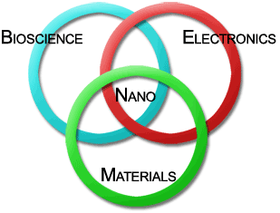
Venn diagram representation for Nano

Slide 5
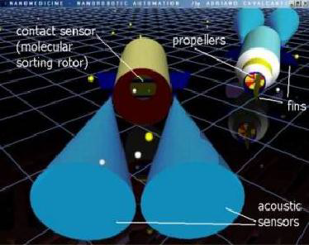
STRUCTURE OF NANO ROBOT
It is constructed with various Nano mechanical devices and Nano sensors like.
              Molecular sorting rotors
              Propeller
              Fins
              sensors

Slide 6
MOLECULAR SORTING ROTORS
It is made up of carbon nanotubes. Simply a sheet of carbon atom forms a carbon nanotube.
In that, a roll having only one sheet of carbon atoms is known as single walled carbon nanotubes (SWNT). Thus the electrical properties of SWNT’s can be used to generate mechanical motion from electrical energy.
One of the main advantages of these SWNT’s is operating at the molecular level and they substitute Nano gears with axle for changing the direction of movement.

Slide 7
PROPELLER
The word propeller in ship is used to drive forward the device against water. Like that in Nano robots it is used to drive forward against the blood stream. Fins , fitted along with the propellers, are used to propel the device.

Slide 8
INJECTION OF NANOROBOTS
we made the Nano robots smaller than the blood vessels as it can travel.
Femoral artery in the leg is considered to be a largest artery in our body.
The Nano robot is injected trough this artery.

Slide 9
NAVIGATION
In order to move the Nano robots in blood flow, following things are very important ..
    Speed of blood
    Get through the heart without struck
    React with changes in blood flow rate
    Able to change the direction according to the blood stream
To satisfy the above consideration we have to make the Nano robots with electric motors turning propellers.

Slide 10
Positioning
To know the location of Nano robots where it goes we use ultrasonic technique.
Nano robots must be able to produce ultrasonic waves by passing a signal to piezoelectric membrane, which is in built with the device.
Several signal processing techniques are used to track this ultrasonic signal and finding the location at any time.
Instead of ultrasonic wave we use infrared ray for signal processing.

Slide 11
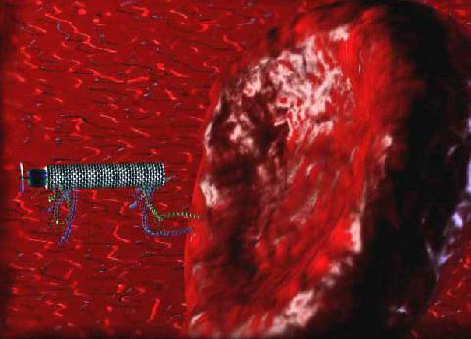

Slide 12
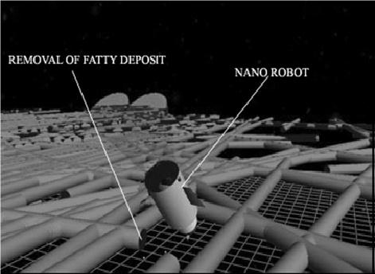
REMOVAL OF DEPOSITS
The fatty deposits (or) clots are
removed using special blades fitted
with Nano robots.
fluids can’t get inside Nano robot.
replicators are not used.

Slide 13

Advantages
Fast process
Results are accurate, as the scale of operation is small.
Involves less psychological strain compared to angioplasty.
Harmful ray attack is reduced.
Advanced and reliable technology.
Aftereffects are eliminated

Slide 14

Disadvantages
Expensive technology
Practical implementation is some what difficult.
Technology problems such as artificial reconstruction and artificial intelligence which results in robots going out of control of humans.

Slide 15
Conclusion
A major asset of Nano robots is the fact that the individual units require very little energy to operate.
Durability is another Potential asset. High speed is also a significant consideration.
For all those who suffer from heart problems these Nano robots are going to be a God given medicine.
In the near future we are going to have our medical field completely out of knives and pain.
Expecting a fast advancement in the field we have this proposal to the world.

Slide 16

Thanks for your attention…!!!
Any Queries ??

Slide 17


